Slide 1
Maximum Value From Your Pharmacy Benefits
Date or Subtitle
Prepared for
Client/Prospect name or logo here

Slide 2
Challenges
In the Industry
Affordability
Complex chronic diseases
Political and regulatory environment
Drug shortages
Many PBMs not aligned to create savings for client/patient
Holistic health models
For the Member
Affordability
Access to life-saving drugs
Finding and understanding options
Complex process to navigate
Lack of tools and resources to improve their health
Adherence to prescribed medications

Slide 3
WellDyne fast facts
Notes:
Privately owned and founded in 1990

Slide 4
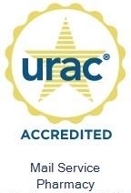
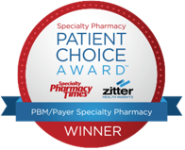
All the services you need from one PBM partner
Specialty Pharmacy
Less than 2% of members are driving more than 50% of plan costs – we take great care of these patients
Mail Order Pharmacy
Today, more than ever, consumers appreciate the convenience of home delivery for their medications
Clinical Programs
Helping to make sure members get the right drug at the best possible cost
Member Services
Helping members get the most value from their pharmacy benefits
PBM Services
Mail Order Pharmacy
Specialty Pharmacy
Clinical Programs
Member Services

Slide 5
Member Engagement

Slide 6
We view every member interaction as an opportunity
Member Services
Text Messages
Self Service
Smart screens display member data in real-time during each call
Proactively answering the unasked questions – so no call back is needed
Hyper-personalized information sent via text
Promotes member savings, better outcomes and increased satisfaction
Cost savings from a different drug or distribution channel
Staying adherent
Disease and therapy education
Notes:
Every interaction is an opportunity to delight a member, achieve savings or improve outcomes
Equipping our Service Team with Integrated Data to Better Serve Callers
Empowering our Clinicians With Data for Impactful Interactions with Prescribers
Making it easy for members to make informed, good decisions

Slide 7
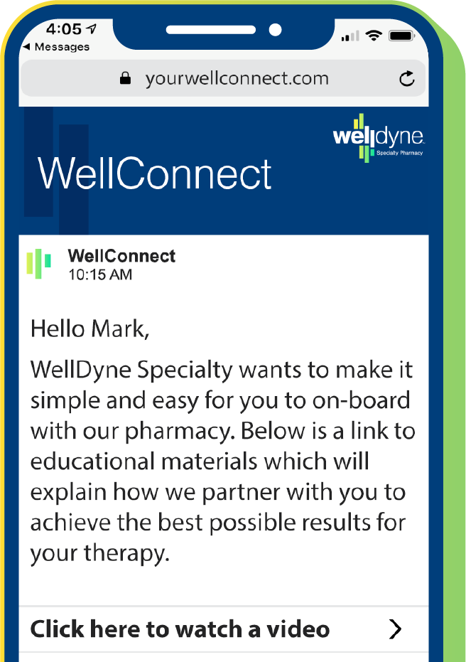
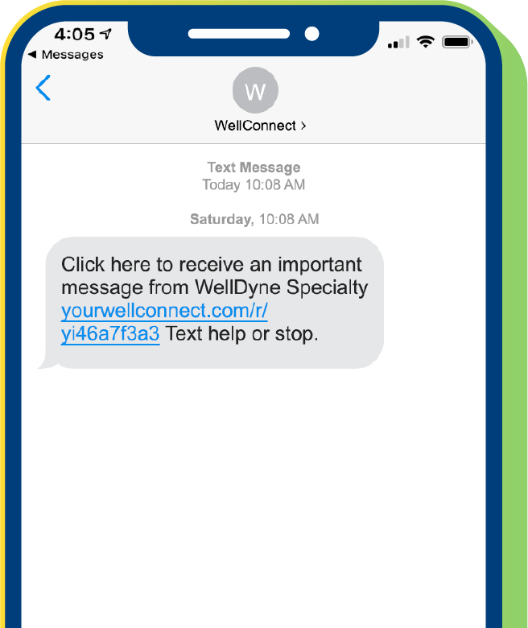
Patients engage more with text messaging
81%
Take action on refill reminders
People Prefer Texts*
>50%
82
%
View patient education messages
25
%
36%
Increase in medication adherence
*In general, 82% of text messages are read within 5 minutes while consumers only open 1 in 4 emails.
Notes:
Healthcare consumers appreciate easy access to helpful information, personalized for their situation, on the device they use most. And in general, 82% of text messages are read within 5 minutes while consumers only open 1 in 4 emails.
That’s why we launched WellConnect. This HIPAA-secure platform allows us to provide highly personalized and actionable information including education, cost saving opportunities, adherence reminders and prior authorization updates.
Each message is data driven and specific for the individual member.
People prefer texts and our metrics reflect that. Over 50% of all patient education messages were viewed and nearly 50% of all savings opportunities we sent resulted in the member taking action.

Slide 8
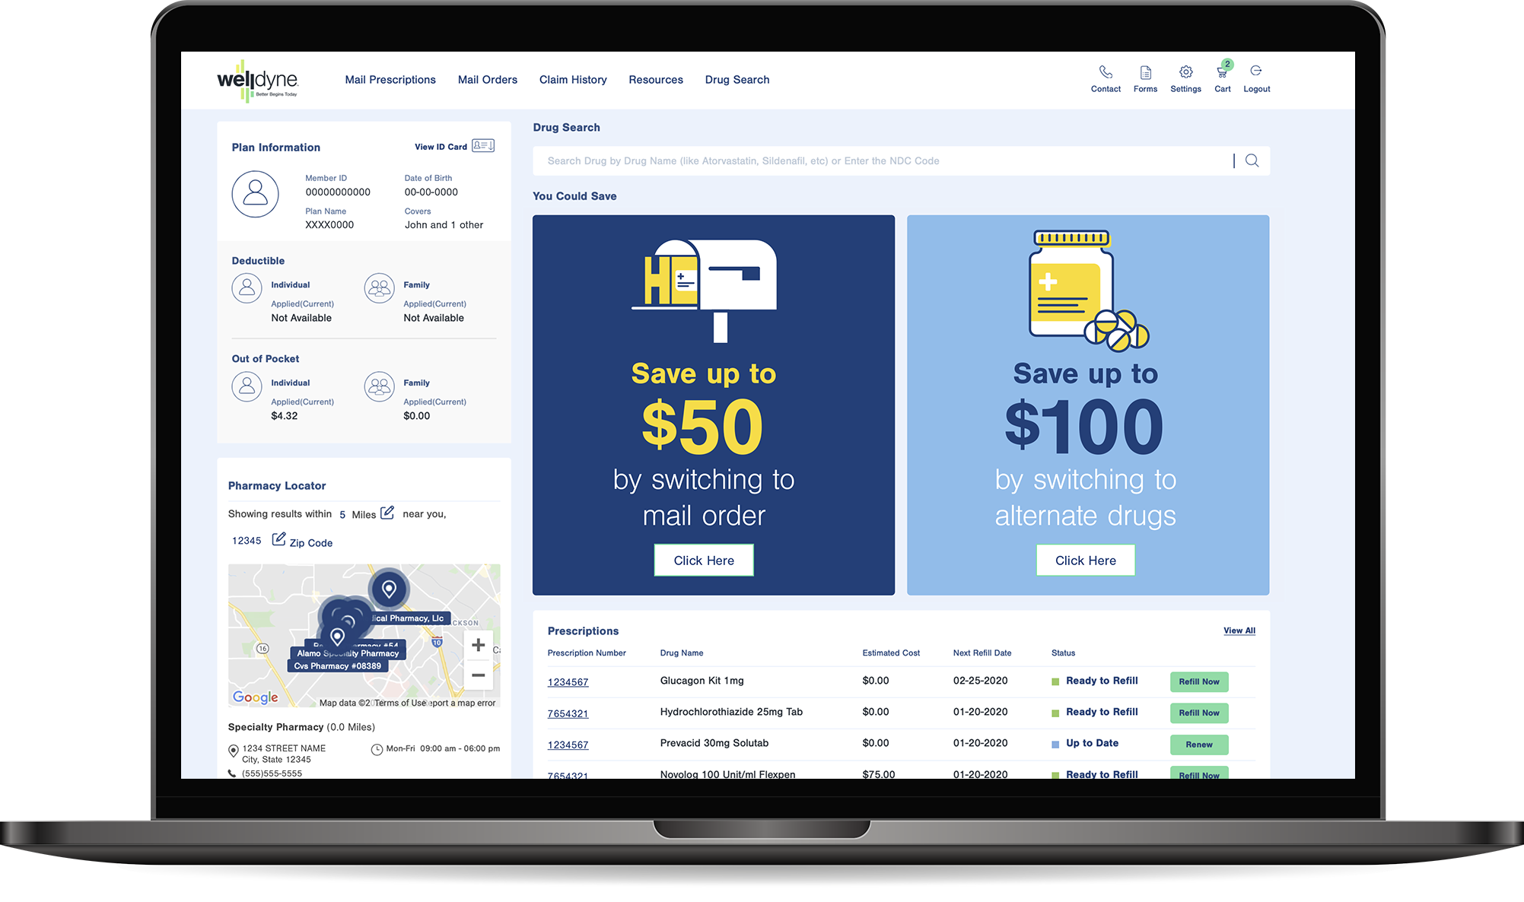
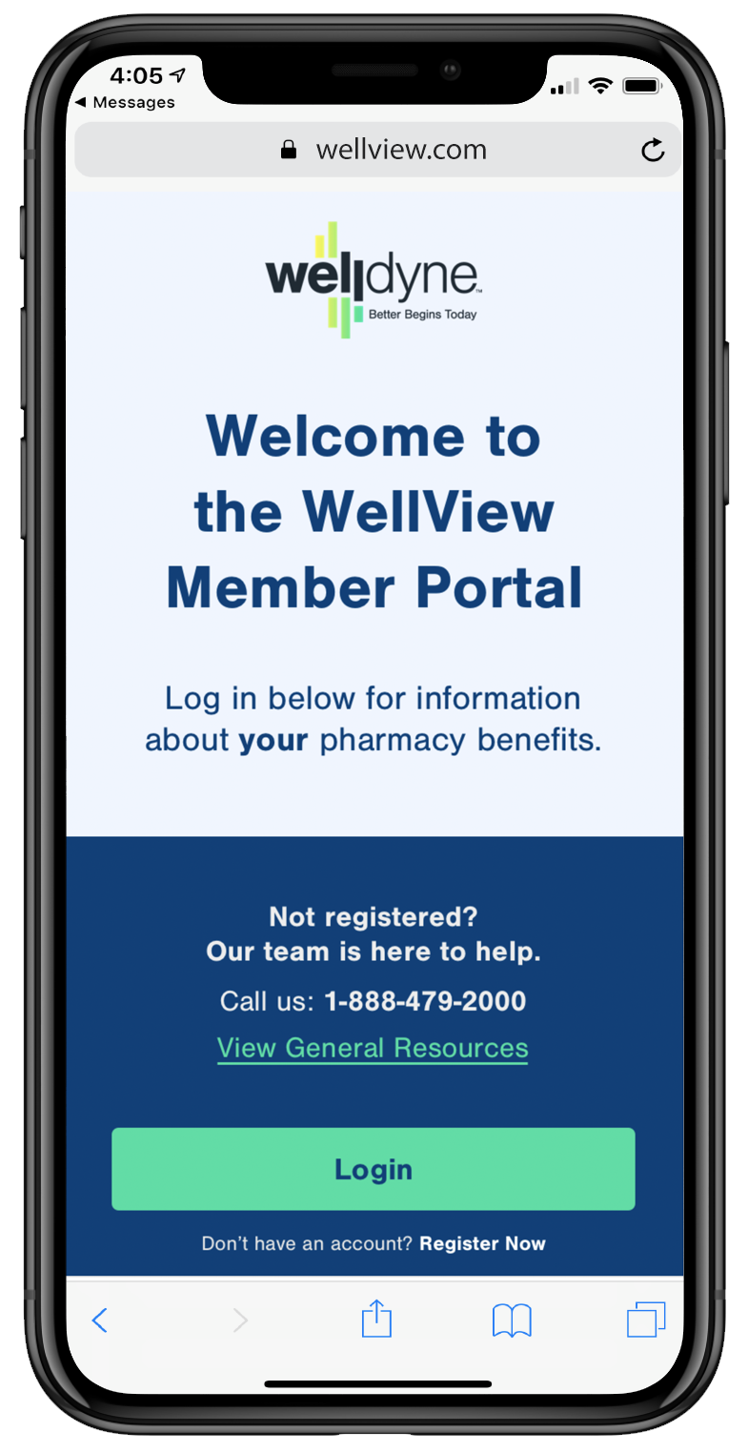
Self-service technology for members
WellView member portal and mobile app
Drug pricing transparency
Real-time savings opportunities
Full mail order support
Digital ID card and pharmacy locator
Deductible and OOP monitoring
Manage family prescriptions
Drug resource library
Formulary integration
by switching to alternate drugs

Slide 9
Specialty Pharmacy

Slide 10
Specialty: A complex, high-cost challenge
Average Annual Drug Costs¹
Ten therapeutic categories are driving
Specialty is now
50%
87%
of total drug spend² (60% expected in 2021)
of total specialty spend³
11%
65%
National average specialty trend
New drug launches will be specialty therapies⁴ (projected between 2019-2023)
Radar on Specialty Pharmacy. February 2020. Volume 17, Number 2
Prime Therapeutics. The Inevitable Increase in Specialty Growth. November 14, 2017. Accessed October 1, 2018.
Artemetrx. 2019 State of Specialty Spend and Trend Report, 2018 Results. Published October 2019
IQVIA. The Global Use of Medicine in 2019 and Outlook to 2023. Published January 29, 2019

Slide 11
Personalized programs for better care
We simplify the patient journey by providing the support needed to start and stay on therapy
Unique approaches that vary by condition
Dedicated care teams focused on primary condition
Better, more tailored onboarding and assistance
Care plan personalized to a member’s health situation
Regular touchpoints to assess adherence and provide education and side-effect management
Coordinated engagement with providers
Better Cost
Better Care
Better Engagement

Slide 12
A proven approach with consistent results
Better Care
Better Engagement
Better Cost
94%
Overall specialty adherence
51%
Engagement with WellConnect Messages
6.4%
Specialty Trend
67%
Prior authorization approval rate
75%
Patients with First Fill Consult
15%
Therapy cost reduction due to WellAssist
76
Net Promoter Score
>90%
Patients opt in to WellManaged programs​
25%
Reduction in Medical Specialty Spend
Notes:
Key Takeaway: Specialty patients are dealing with complex conditions that require special handling and support. We believe that providing better care allows for better engagement which ultimately results in better costs.

Slide 13
Getting Started

Slide 14
Preparing for a smooth implementation
Partnership: A Growth Mindset
People Partnership Goals, Capacity Planning
Process Continuous Improvement/ Efficiencies, Strategies
Technology Automated Workflow, WellConnect
Control/ Monitor
Voice of the Customer
Accountable Execution
Regular Meetings
Action Assessment Effort/Impact
Roadmap
Short and Long-term

Slide 15
Detailed implementation process ensures smooth go-live
1
2
3
4
5
Kick-Off
Clear expectations of process and accountabilities
Requirements
Client commitments, milestones, success factors
Configure/Build
Eligibility, clinical data requirements, service reporting
Test/Prepare
Validate inputs/outputs, system training
Deploy
Go-live, monitoring, team transition

Slide 16
Better results for our TPA clients
Proven big PBM experience and programs in a middle-market offering
Strong clinical programs to tightly manage drug costs and help plan sponsors achieve their goals
Tight operational controls with superior implementation process and execution
Ability to fully align ourselves with client intent
Flexible and scalable approach to meet unique needs
A 30-year history powered by new leadership and big technology investments for a fresh alternative.

Slide 17
Discussion

